Slide 1
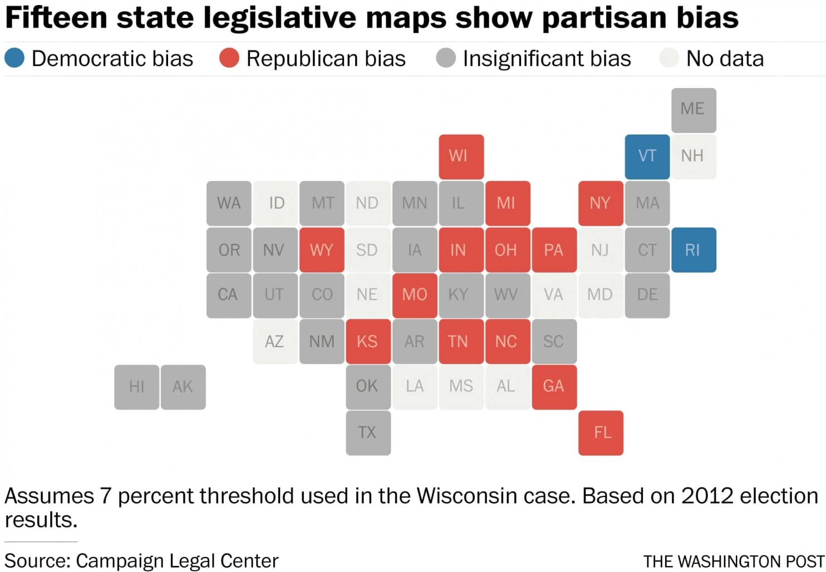
Tidy data & gerrymandering
Geog4/6300-Shannon

Slide 2
Transforming data
Notes:
Where could we go at this point? Depends on what we’re interested in.
Could cut out this outlier month from the analysis if you’re interested in “normal” weather patterns
Or could be start of a project on how hurricanes affect weather data (and weather) in the region. Or how ecosystems respond differently to outlier events to regular ones (wet March vs. Sept. hurricane).
Important part of this: we didn’t start out with a theory we wanted to test. Rather, we started with data which led to questions. Different kind of process.

Slide 3
Transforming data--Why?
“Tidy” the data
Useful for data analysis/visualization
Apply a function across multiple variables
Notes:
Where could we go at this point? Depends on what we’re interested in.
Could cut out this outlier month from the analysis if you’re interested in “normal” weather patterns
Or could be start of a project on how hurricanes affect weather data (and weather) in the region. Or how ecosystems respond differently to outlier events to regular ones (wet March vs. Sept. hurricane).
Important part of this: we didn’t start out with a theory we wanted to test. Rather, we started with data which led to questions. Different kind of process.

Slide 4
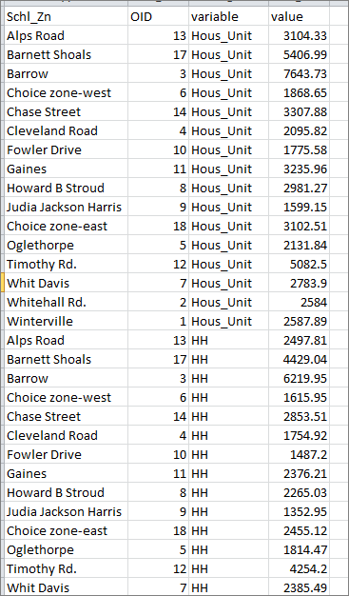
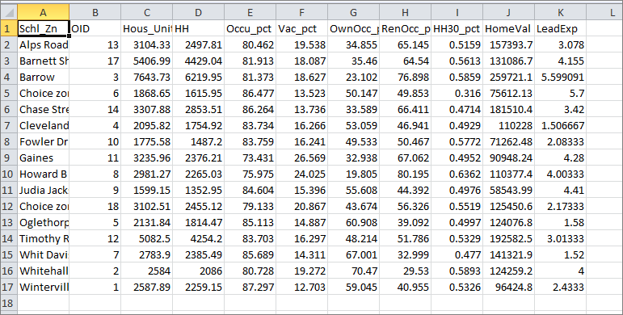
Wide and long format
Notes:
Where could we go at this point? Depends on what we’re interested in.
Could cut out this outlier month from the analysis if you’re interested in “normal” weather patterns
Or could be start of a project on how hurricanes affect weather data (and weather) in the region. Or how ecosystems respond differently to outlier events to regular ones (wet March vs. Sept. hurricane).
Important part of this: we didn’t start out with a theory we wanted to test. Rather, we started with data which led to questions. Different kind of process.

Slide 5
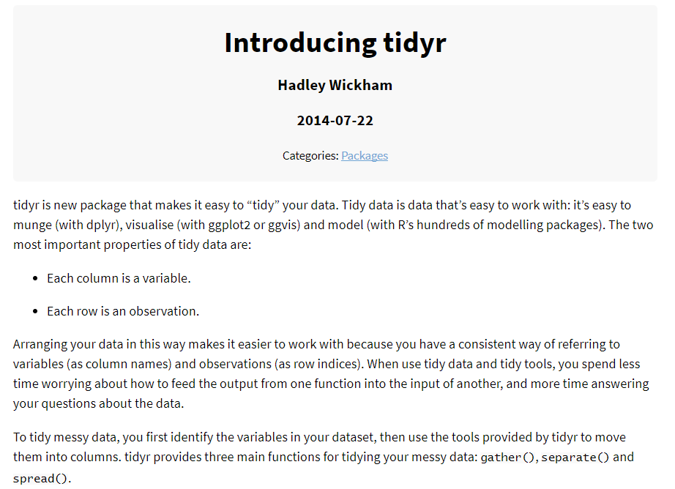

In the tidyverse: tidyr
Notes:
Where could we go at this point? Depends on what we’re interested in.
Could cut out this outlier month from the analysis if you’re interested in “normal” weather patterns
Or could be start of a project on how hurricanes affect weather data (and weather) in the region. Or how ecosystems respond differently to outlier events to regular ones (wet March vs. Sept. hurricane).
Important part of this: we didn’t start out with a theory we wanted to test. Rather, we started with data which led to questions. Different kind of process.

Slide 6

“Gather” data
Just ID variables are retained
Data variables listed in a single column
L
O
N
G
WIDE
Notes:
Where could we go at this point? Depends on what we’re interested in.
Could cut out this outlier month from the analysis if you’re interested in “normal” weather patterns
Or could be start of a project on how hurricanes affect weather data (and weather) in the region. Or how ecosystems respond differently to outlier events to regular ones (wet March vs. Sept. hurricane).
Important part of this: we didn’t start out with a theory we wanted to test. Rather, we started with data which led to questions. Different kind of process.

Slide 7

“Spread” data
Add new variables based on current categorical variable
L
O
N
G
WIDE
Notes:
Where could we go at this point? Depends on what we’re interested in.
Could cut out this outlier month from the analysis if you’re interested in “normal” weather patterns
Or could be start of a project on how hurricanes affect weather data (and weather) in the region. Or how ecosystems respond differently to outlier events to regular ones (wet March vs. Sept. hurricane).
Important part of this: we didn’t start out with a theory we wanted to test. Rather, we started with data which led to questions. Different kind of process.

Slide 8

Let’s try it out!
Notes:
Where could we go at this point? Depends on what we’re interested in.
Could cut out this outlier month from the analysis if you’re interested in “normal” weather patterns
Or could be start of a project on how hurricanes affect weather data (and weather) in the region. Or how ecosystems respond differently to outlier events to regular ones (wet March vs. Sept. hurricane).
Important part of this: we didn’t start out with a theory we wanted to test. Rather, we started with data which led to questions. Different kind of process.

Slide 9
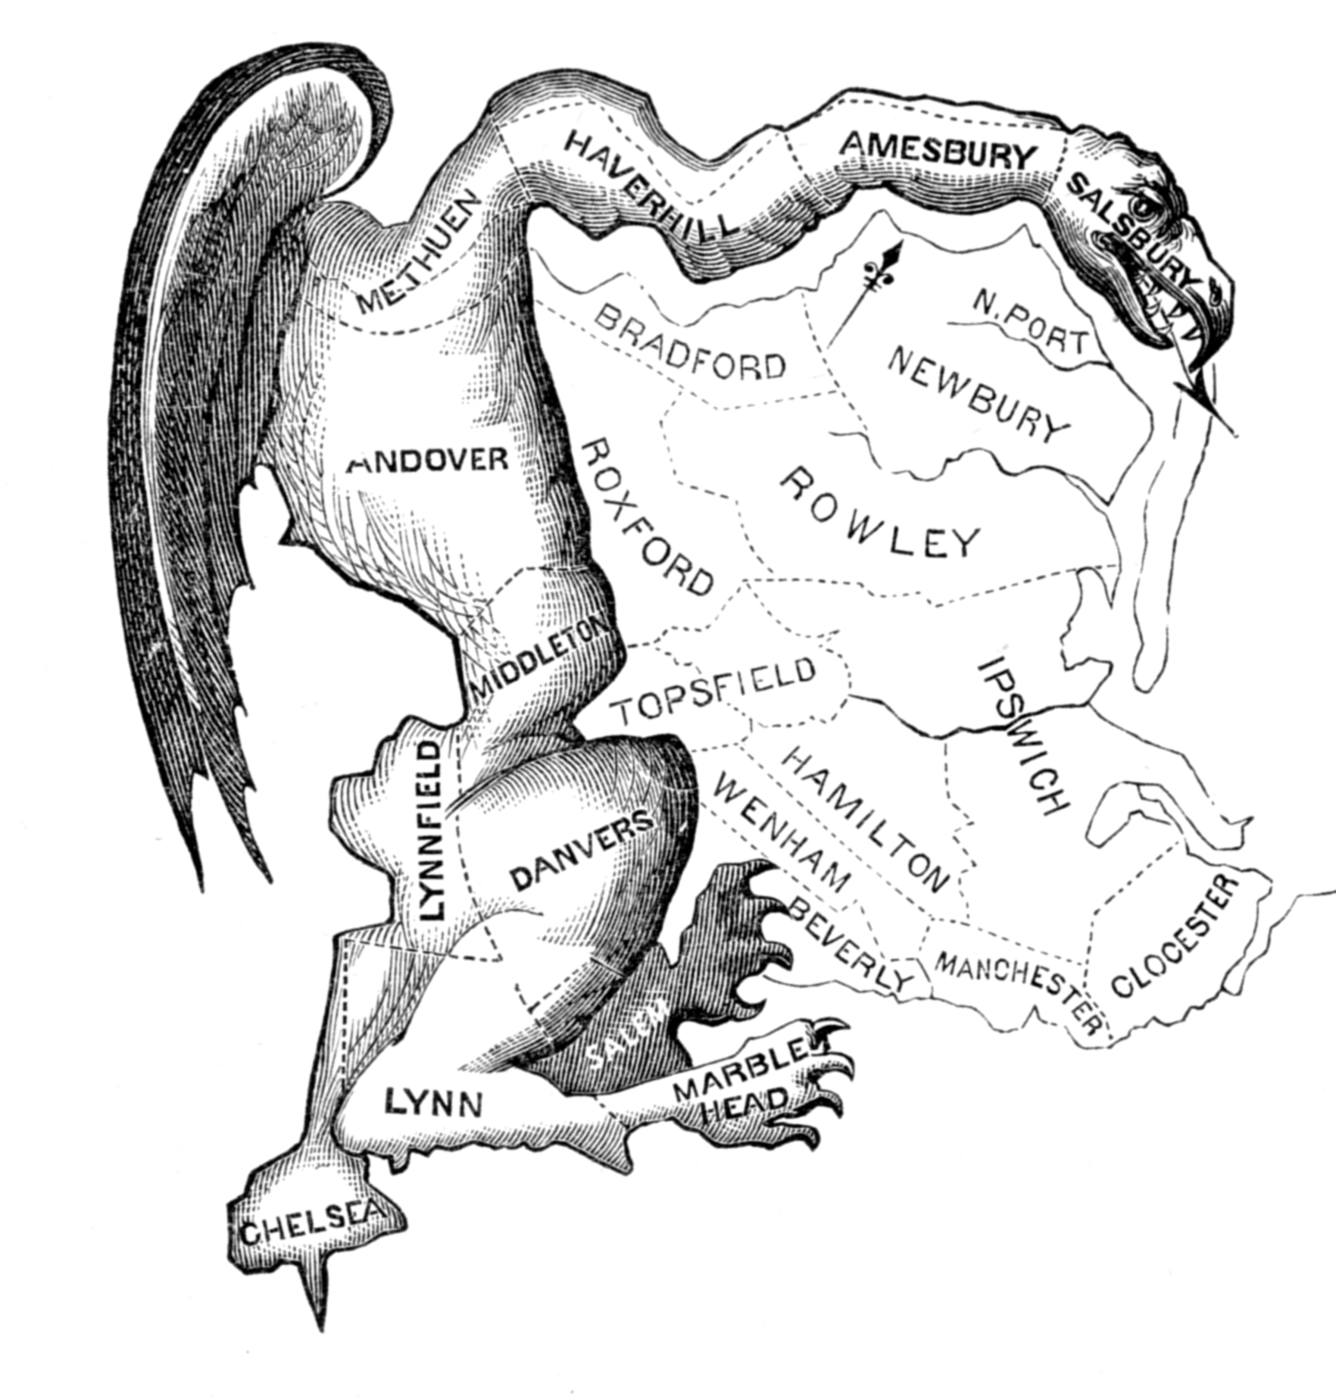
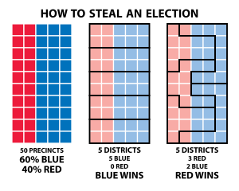
Gerrymandering
What stood out to you from these pieces?
What questions did you have?
Would you be interested in exploring this more as a final project?
Notes:
Where could we go at this point? Depends on what we’re interested in.
Could cut out this outlier month from the analysis if you’re interested in “normal” weather patterns
Or could be start of a project on how hurricanes affect weather data (and weather) in the region. Or how ecosystems respond differently to outlier events to regular ones (wet March vs. Sept. hurricane).
Important part of this: we didn’t start out with a theory we wanted to test. Rather, we started with data which led to questions. Different kind of process.

